Slide 2
ADVANCED SQL
PL/SQL
PROCEDURES
FUNCTIon
Notes:
Procedure is similar to programming lang procedure were group of SQL statements can be executed. Defined/cretaed to do particular task. Similar to programing lang it also has declrataion and body part.
Triggers are the PL/SQL block which is associated with table and when ever modification happens to the table the trigger is fired. Which is going to take or execute specified actions.

Slide 3
PL/SQL
PL/SQL is Oracle's procedural language extension to SQL, the non-procedural relational database language.
With PL/SQL, you can use SQL statements to manipulate ORACLE data and the flow of control statements to process the data. Moreover, you can declare constants and variables, define subprograms (procedures and functions), and trap runtime errors.
Thus, PL/SQL combines the data manipulating power of SQL with the data processing power of procedural languages.

Slide 4
DIFFERENCE BETWEEN PL/SQL AND SQL
When a SQL statement is issued on the client computer, the request is made to the database on the server, and the result set is sent back to the client.
As a result, a single SQL statement causes two trips on the network. If multiple SELECT statements are issued, the network traffic increase significantly very fast. For example, four SELECT statements cause eight network trips.
If these statements are part of the PL/SQL block, they are sent to the server as a single unit. The SQL statements in this PL/SQL program are executed at the server and the result set is sent back as a single unit. There is still only one network trip made as is in case of a single SELECT statement.

Slide 5
PL/SQL BLOCKS
PL/SQL blocks can be divided into two groups:
Named and
Anonymous.
Named blocks are used when creating subroutines. These subroutines are procedures, functions, and packages.
The subroutines can be stored in the database and referenced by their names later on.
In addition, subroutines can be defined within the anonymous PL/SQL block.
Anonymous PL/SQL blocks do not have names. As a result,they cannot be stored in the database and referenced later.

Slide 6
PL/SQL BLOCK STRUCTURE
PL/SQL blocks contain three sections
Declare section
Executable section and
Exception-handling section.
The executable section is the only mandatory section of the block.
Both the declaration and exception-handling sections are optional.

Slide 7
PL/SQL BLOCK STRUCTURE
PL/SQL block has the following structure:
DECLARE
Declaration statements
BEGIN
Executable statements
EXCEPTION
Exception-handling statements
END ;

Slide 8
DECLARATION SECTION
The declaration section is the first section of the PL/SQL block.
It contains definitions of PL/SQL identifiers such as variables, constants, cursors and so on.
Example
DECLARE
v_first_name VARCHAR2(35) ;
v_last_name VARCHAR2(35) ;
v_counter NUMBER := 0 ;

Slide 9
EXECUTABLE SECTION
The executable section is the next section of the PL/SQL block.
This section contains executable statements that allow you to manipulate the variables that have been declared in the declaration section.
BEGIN
SELECT first_name, last_name
FROM student
WHERE student_id = 123 ;
DBMS_OUTPUT.PUT_LINE
(‘Student name :’ || first_name ||‘ ’|| last_name);
END;

Slide 10
EXCEPTION-HANDLING SECTION
The exception-handling section is the last section of the PL/SQL block.
This section contains statements that are executed when a runtime error occurs within a block.
Runtime errors occur while the program is running and cannot be detected by the PL/SQL compiler.
EXCEPTION
WHEN NO_DATA_FOUND THEN
DBMS_OUTPUT.PUT_LINE
(‘ There is no student with student id 123 ’);
END;

Slide 11
PL/SQL EXAMPLE
DECLARE
v_first_name VARCHAR2(35);
v_last_name VARCHAR2(35);
BEGIN
SELECT first_name, last_name
INTO v_first_name, v_last_name
FROM student
WHERE student_id = 123;
DBMS_OUTPUT.PUT_LINE
('Student name: '||v_first_name||' '||v_last_name);
EXCEPTION
WHEN NO_DATA_FOUND THEN
DBMS_OUTPUT.PUT_LINE
('There is no student with student id 123');
END;

Slide 12
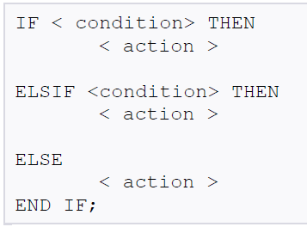
Programmatic Control Constructs
If-Then-ElsIf-Else-End If :

Slide 13
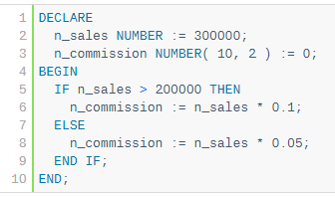

Slide 14
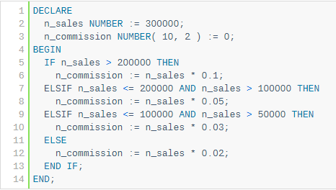

Slide 15
BASIC LOOPS IN PL/SQL
sequence of statements is enclosed between the LOOP and the END LOOP statements. At each iteration, the sequence of statements is executed and then control resumes at the top of the loop.

Slide 16
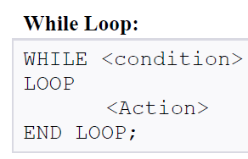
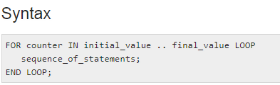
Notes:
The value of index starts from lower_bound and increases by one with each iteration of the loop until it reaches upper_bound. If the upper_bound value is less than the lower_bound, then the statements never executed. The Reverse option is used to start the index value from the upper_bound and index is decremented by one in each iteration till index value reaches lower_bound.

Slide 17
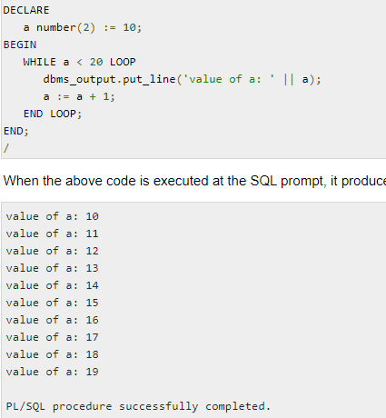

Slide 18
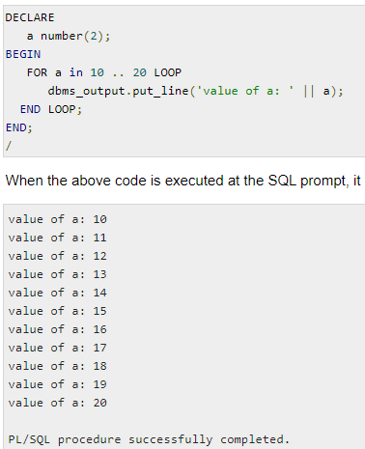

Slide 19
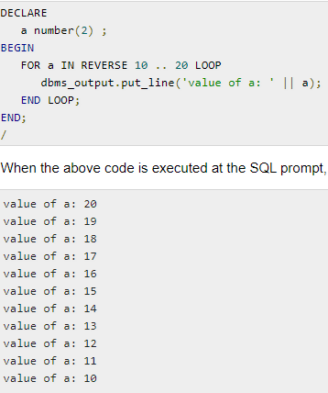
Reverse FOR LOOP Statement

Slide 20
Case Statement
CASE [TRUE | selector]
WHEN expression1 THEN
sequence_of_statements1;
WHEN expression2 THEN
sequence_of_statements2;
...
WHEN expressionN THEN
sequence_of_statementsN;
[ELSE sequence_of_statementsN+1;]
END CASE [label_name];

Slide 21
// Case statement
DECLARE
grade CHAR(1);
BEGIN
grade := 'B';
CASE grade
WHEN 'A' THEN DBMS_OUTPUT.PUT_LINE('Excellent');
WHEN 'B' THEN DBMS_OUTPUT.PUT_LINE('Very Good');
WHEN 'C' THEN DBMS_OUTPUT.PUT_LINE('Good');
ELSE DBMS_OUTPUT.PUT_LINE('No such grade');
END CASE;
Notes:
--Simulating STEP Clause in FOR LOOP Statement
DECLARE step PLS_INTEGER := 5;
BEGIN
FOR i IN 1..3 LOOP
DBMS_OUTPUT.PUT_LINE (i*step);
END LOOP; END; /

Slide 22
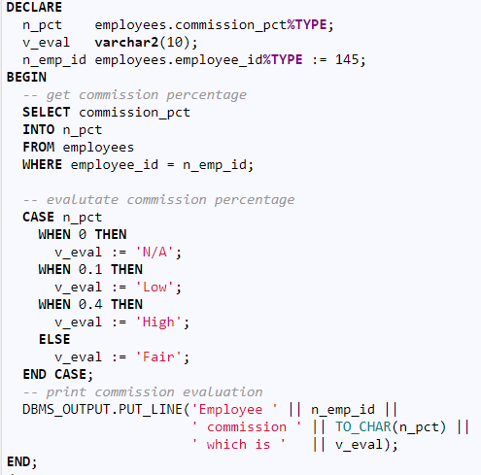

Slide 23
Procedure
A Procedure is a subprogram unit that consists of a group of PL/SQL statements. Each procedure in Oracle has its own unique name by which it can be referred. This subprogram unit is stored as a database object.
A stored procedure or in simple term, a proc is a named PL/SQL block which performs one or more specific task. This is similar to a procedure in other programming languages.

Slide 24
PROCEDURES
The syntax for creating a procedure is as follows:
CREATE OR REPLACE PROCEDURE name
(<parameterl IN/OUT <datatype>)
[AS | IS]
[local declarations]
BEGIN
executable statements
[EXCEPTION
exception handlers]
END [name];

Slide 25
CREATE PROCEDURE instructs the compiler to create new procedure. Keyword 'OR REPLACE' instructs the compile to replace the existing procedure (if any) with the current one.
Procedure name should be unique.
Keyword 'IS' will be used, when the procedure is nested into some other blocks. If the procedure is standalone then 'AS' will be used. Other than this coding standard, both have the same meaning

Slide 26
CREATE OR REPLACE PROCEDURE greetings
AS
BEGIN
dbms_output.line(“Hello world”);
END;
--------------------------------------------
When the above code is executed using the SQL prompt, it will produce the following result − PROCEDURE CREATED
EXECUTE greetings;

Slide 27
create table named emp have two column id and salary with number datatype.
CREATE OR REPLACE PROCEDURE emp_insert(id IN NUMBER, sal IN NUMBER) IS
BEGIN
INSERT INTO emp VALUES(id, sal);
DBMS_OUTPUT.PUT_LINE('VALUE INSERTED.');
END;
/
Procedure created.
SET SERVEROUTPUT ON;
EXECUTE emp_insert(101,2000);
procedure successfully completed.

Slide 28
// Insert a person information into a PERSON table provided his information does not exist already.
CREATE OR REPLACE PROCEDURE insertPerson ( id IN VARCHAR, DOB IN DATE, fname IN VARCHAR, lname IN VARCHAR)
IS
counter INTEGER; --declaration part
BEGIN
SELECT COUNT(*) INTO counter FROM person p WHERE p.pid = id;
IF (counter > 0) THEN
-- person with the given pid already exists
DBMS_OUTPUT.PUT_LINE('WARNING Inserting person: person with pid ' || id || ' already exists!');
ELSE
INSERT INTO person VALUES (id, DOB, fname, lname);
DBMS_OUTPUT.PUT_LINE('Person with pid ' || id || ' is inserted.');
END IF;
END;
/

Slide 29
Example
In order to execute a procedure use the following syntax:
EXECUTE Procedure_name;
Or EXEC Procedure_name;
SQL> EXECUTE insertPerson (‘p1’, ’10-10-2000’, ‘John’, ’Smith’) ;
To see the o/p on the screen use following command
SET SERVEROUTPUT ON

Slide 30
Parameter
The parameter is variable or placeholder of any valid PL/SQL datatype through which the PL/SQL subprogram exchange the values with the main code. This parameter allows to give input to the subprograms and to extract from these subprograms.
These parameters should be defined along with the subprograms at the time of creation.
These parameters are included in the calling statement of these subprograms to interact the values with the subprograms.
The datatype of the parameter in the subprogram and the calling statement should be same.
The size of the datatype should not mention at the time of parameter declaration, as the size is dynamic for this type.

Slide 31
PARAMETERS
Parameters are the means to pass values to and from the calling environment to the server.
These are the values that will be processed or returned via the execution of the procedure.
There are three types of parameters:
IN, OUT, and IN OUT.
IN passes value into the procedure, OUT passes back from the procedure and INOUT does both.

Slide 32
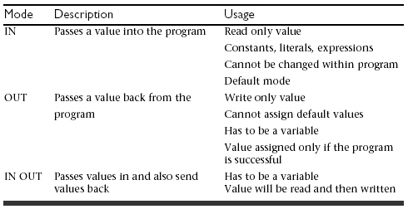
Types of Parameters

Slide 33
// Procedure calls another procedure
CREATE OR REPLACE PROCEDURE insertFaculty (pid IN VARCHAR, DOB IN DATE, fname IN VARCHAR, lname IN VARCHAR, rank IN VARCHAR, dept IN VARCHAR) IS
BEGIN
insertPerson (pid, DOB, fname, lname); // User defined Procedure
insert into facultyEDB values(pid, rank, dept);
DBMS_OUTPUT.PUT_LINE('Faculty with pid ' || pid || ' is inserted.');
END insertFaculty;
EXECUTE insertFaculty('121-11-1111', '21-OCT-1961', 'Susan', 'Urban', 'Emeritus', 'CSE');
-- from sql prompt

Slide 34
FUNCTIONS
Functions are a type of stored code and are very similar to procedures.
The significant difference is that a function is a PL/SQL block that returns a single value.
Functions can accept one, many, or no parameters, but a function must have a return clause in the executable section of the function.
The datatype of the return value must be declared in the header of the function.
A function is not a stand-alone executable in the way that a procedure is: It must be used in some context.
A function has output that needs to be assigned to a variable, or it can be used in a SELECT statement.

Slide 35
FUNCTIONS
The function does not necessarily have to have any parameters, but it must have a RETURN value declared in the header, and it must return values for all the varying possible execution streams.
The RETURN statement does not have to appear as the last line of the main execution section, and there may be more than one RETURN statement (there should be a RETURN statement for each exception).

Slide 36
FUNCTIONS
The syntax for creating a function is as follows:
CREATE [OR REPLACE] FUNCTION function_name
(parameter list)
RETURN datatype
IS|AS
BEGIN
<body>
RETURN (return_value);
END;

Slide 37
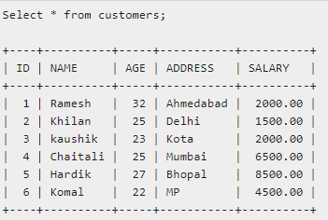

Slide 38
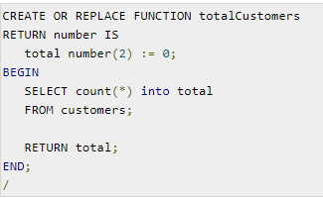

Slide 39
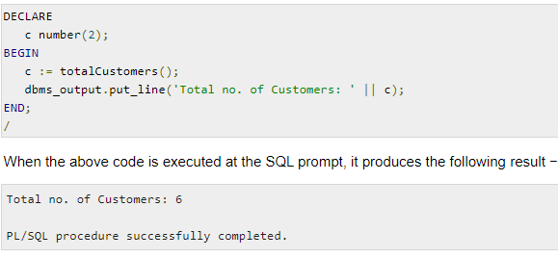

Slide 40
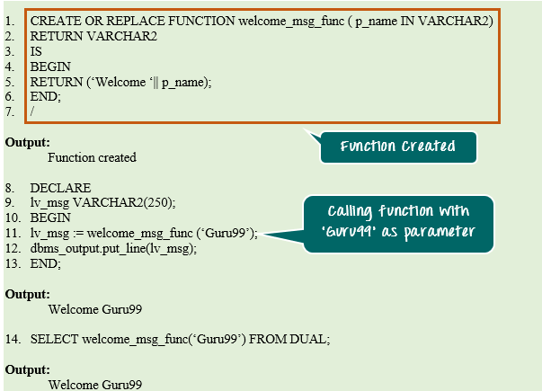

Slide 41
Example
CREATE OR REPLACE FUNCTION show_description (i_course_no IN number)
RETURN varchar2
AS
v_description varchar2(50);
BEGIN
SELECT description
INTO v_description
FROM course
WHERE course_no = i_course_no;
RETURN v_description;
EXCEPTION
WHEN NO_DATA_FOUND
THEN
RETURN('The Course is not in the database');
WHEN OTHERS
THEN
RETURN('Error in running show_description');
END;

Slide 42
Making Use Of Functions
In a anonymous block
DECLARE
v_description VARCHAR2(50);
BEGIN
v_description := show_description(&sv_cnumber);
DBMS_OUTPUT.PUT_LINE(v_description);
END;
In a SQL statement
SELECT course_no, show_description(course_no)
FROM course;
SET SERVEROUTPUT ON
Notes:
In first part we display the description for the enter course value from the keyboard.
In second part we are displaying course no along with its description.

Slide 43
Unit 3 – material
Use of lateral queries

Slide 44
Correlated subqueries and correlation variables
select course id
from section as S
where semester = ’Fall’ and year= 2009 and
exists (select *
from section as T
where semester = ’Spring’ and year= 2010 and
S.course id= T.course id);

Slide 45
The above query also illustrates a feature of SQL where a correlation name from an outer query (S in the above query), can be used in a subquery in the where clause. A subquery that uses a correlation name from an outer query is called a correlated subquery.

Slide 46
Subqueries in the From Clause
however, nested subqueries in the from clause cannot use correlation variables from other relations in the from clause.
SQL:2003 allows a subquery in the from clause that is prefixed by the lateral keyword to access attributes of preceding tables or subqueries in the from clause.
For example, if we wish to print the names of each instructor, along with their salary and the average salary in their department, we could write the query as follows:

Slide 47
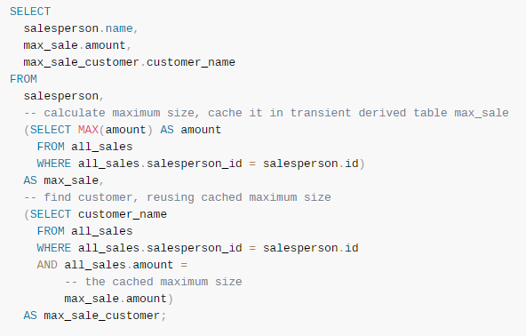

Slide 48
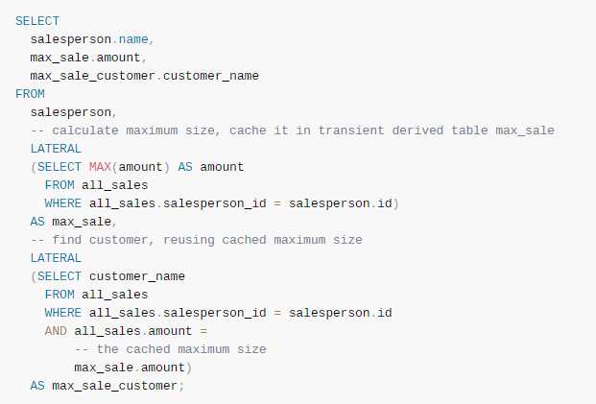
solution

Slide 49
Subqueries in the From Clause: lateral clause
To display instructor, his salary along with his department’s average salary.
select name, salary, avg_salary from instructor I1, lateral (select avg(salary) as avg_salary from instructor I2 where I2.dept_name= I1.dept_name);
Lateral clause permits later part of the from clause (after the lateral keyword) to access correlation variables from the earlier part.
Note: lateral is part of the SQL standard, but is not supported on many database systems; some databases such as SQL Server offer alternative syntax
Notes:
Q: To display instructor, his salary along with his department’s average salary.
49

Slide 50
exercise
For each employee, display his salary along with the number of along with count of other people who have same salary.

Slide 51
Procedures and loops
Processing record(tuple) in for loop, we can use the following syntax:
CREATE PROCEDURE P1
BEGIN
FOR rec IN (select statement)
LOOP
some statements;
END LOOP;
END;
/

Slide 52
WRITE A PROCEDURE TO FETCH NAMES OF EMPLOYEES WHOSE SALARY IS > 100000
CREATE PROCEDURE P1
BEGIN
FOR item IN
(SELECT (first_name || ' ' || last_name) as complete_name
FROM employees
WHERE Salary < 100000
) LOOP
DBMS_OUTPUT.PUT_LINE
('Employee name: ' || item.complete_name);
END LOOP;
END;
/

Slide 53
EX: write a procedure to display every product name and price in descending order from product table
Ex2: write a procedure to display every product name and price in descending order for those product that are priced less than rs.500, from product table

Slide 54
BEGIN
FOR r_product IN (
SELECT
product_name, list_price
FROM
products
ORDER BY list_price DESC
)
LOOP
dbms_output.put_line( r_product.product_name ||
': $' || r_product.list_price );
END LOOP;
END;

